Slide 1
Application Process
USAJOBS – Application Manager
USA STAFFING® —OPM’S AUTOMATED HIRING TOOL FOR FEDERAL AGENCIES

Slide 2
Introduction to USAJOBS
USAJOBS is the official job site of the U.S. Federal Government. In USAJOBS you can:
Create an Account
Build and store up to five distinct resumes.
Look for a Job
Search by Agency, Occupation, Grade, Location, etc.
Be Informed
Learn how to use USAJOBS by accessing their tutorials.
Create and save job searches to receive automatic notifications.
Apply for jobs or save them to review later.
Apply to Federal Agencies.
Learn about the federal hiring process.
Learn about special hiring programs.
View jobs available to the general public and those available to Federal employees.
Application Process • February 2010
2

Slide 3
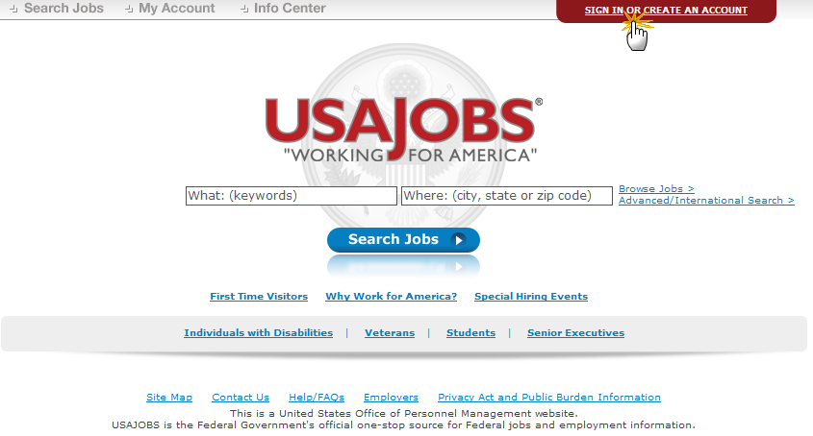
USAJOBS Main Page
To apply for jobs you must have a USAJOBS account. To begin, SIGN IN or CREATE AN ACCOUNT if you have not done so already.
Application Process • February 2010
3

Slide 4
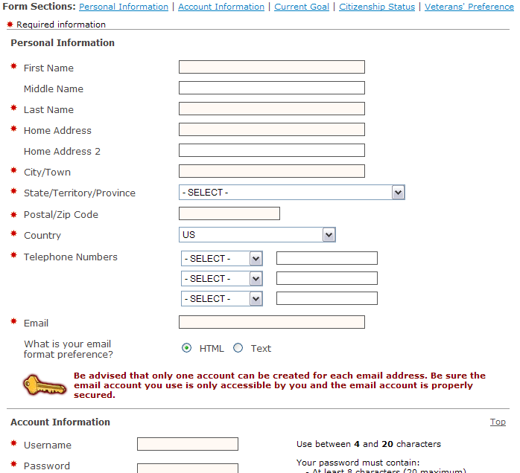
Create an Account
To create an account you must enter some basic Personal Information into the Form Sections.
Application Process • February 2010
4

Slide 5
USAJOBS – My Account Area
Once you’ve filled out the basic profile information and created an account, you can Build a New Resume or Upload a New Resume by selecting one of the options in the Resumes area.
In your USAJOBS account you can:
Build or upload a new Resume
Upload and save Documents required to support your application
Check your Application Status
Create Job Search Agents
Review any Saved Jobs
Application Process • February 2010
5

Slide 6
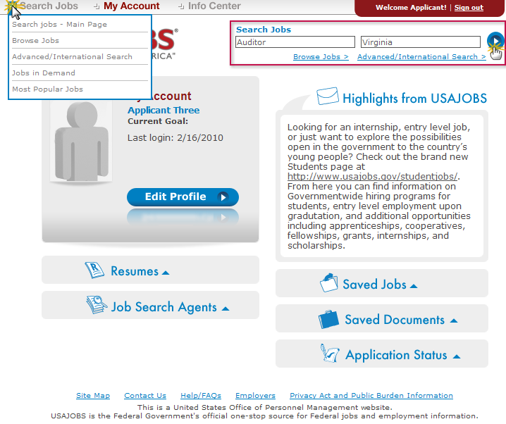
Search Jobs
Once you’ve created an account, built or uploaded a resume, and uploaded any supporting documents, you can begin the job search.
To search for jobs you can go to the Search Jobs area located at the top left or you can Search Jobs directly from this page by using the Keyword and/or Location options at the top right of the screen. For example a keyword search might include the agency name or position title and/or a location such as Virginia.
Application Process • February 2010
6

Slide 7
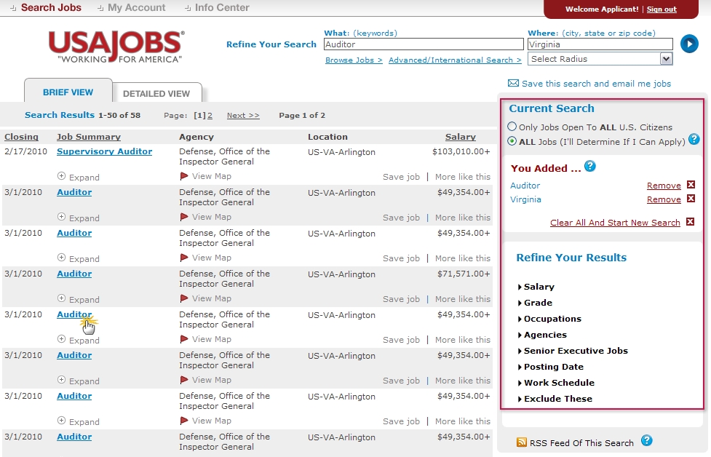
Job Search Results
The Current Search menu located on the right side of the screen tracks your current search and provides filters that allow you to further refine your search results. You can remove and add filters to expand or narrow your search. To open the job announcement, click on the job title.
Application Process • February 2010
7

Slide 8
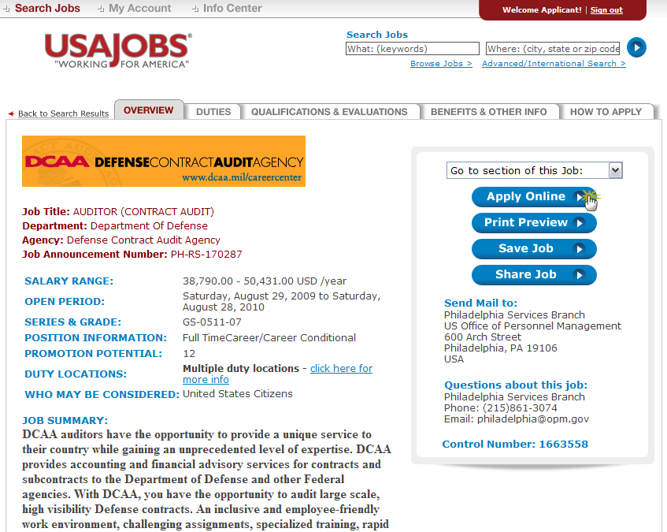
Job Announcement – Apply Online
Once you’ve located a job you are interested in, reviewed the job announcement and the How to Apply instructions, click the Apply Online button.
Application Process • February 2010
8

Slide 9
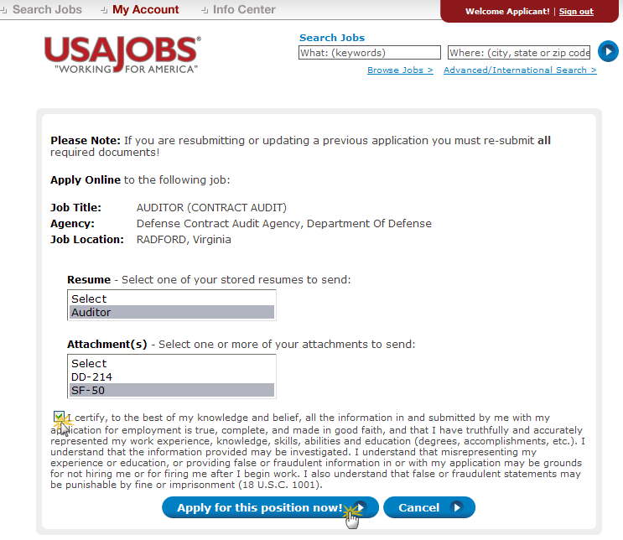
Select Resume and Attachment(s)
After you click Apply Online, you will have the option to select a Resume and any supporting documents (attachments) to be linked to
your application.
Please Note: If you are updating a previously submitted application, you must re-submit your Resume and all applicable supporting documents.
After you click Apply for this position now!, USAJOBS will redirect you to Application Manager.
Application Process • February 2010
9

Slide 10
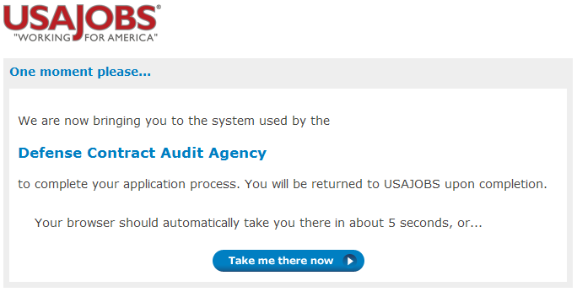
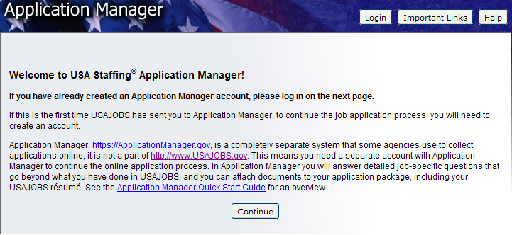
Transition to USA Staffing® - Application Manager
Application Manager is a separate Federal system from USAJOBS. It is used by many Federal agencies to collect online applications and assessment information for specific positions.
Application Process • February 2010
10

Slide 11
Application Manager
With Application Manager you can:
Work on, submit, and track your application packages.
Check the status of each application package (e.g., not submitted, complete, incomplete)
Use the Application Package Checklist to keep track of an application’s requirements.
View and print your Assessment Questionnaire responses and any of the documents submitted with an application.
Select and re-use documents submitted for previous applications in any new application.
Review any correspondence sent to you by hiring agencies.
Review and update your personal information at any time.
Application Process • February 2010
11

Slide 12
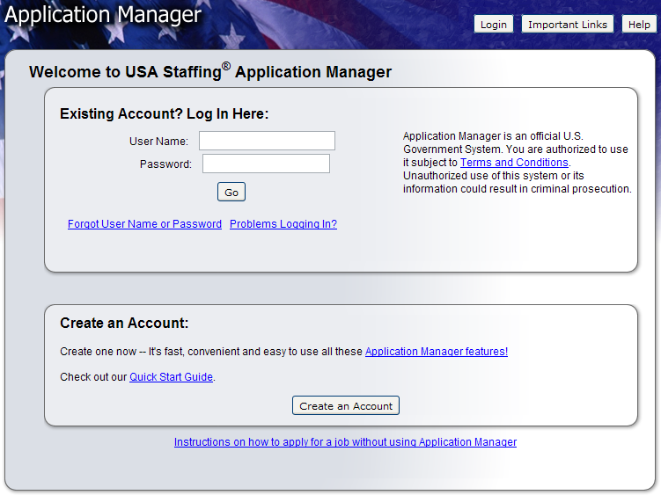
Application Manager
If you have an Application Manager account, you can log in by entering your User Name and Password or if you don’t already have an account, you can create one.
After you first access Application Manager from USAJOBS, your accounts will become linked and you will not be required to login to Application Manager when redirected from USAJOBS.
Application Process • February 2010
12

Slide 13
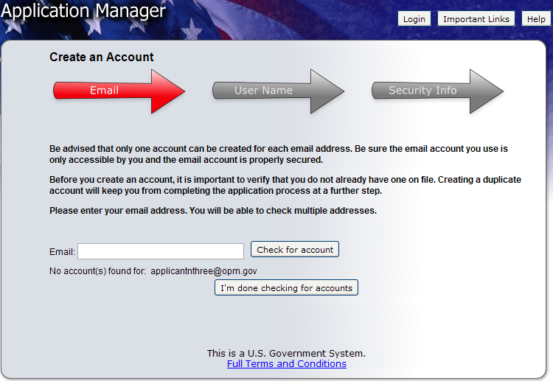
Create an Application Manager Account
Follow the screen prompts to create an Application Manager account. Before you create an account, it is important to verify that you don’t already have one on file.
Enter your email address to check if you have an account. Once you’ve verified no accounts are found, click I’m done checking for accounts to proceed.
Application Process • February 2010
13

Slide 14
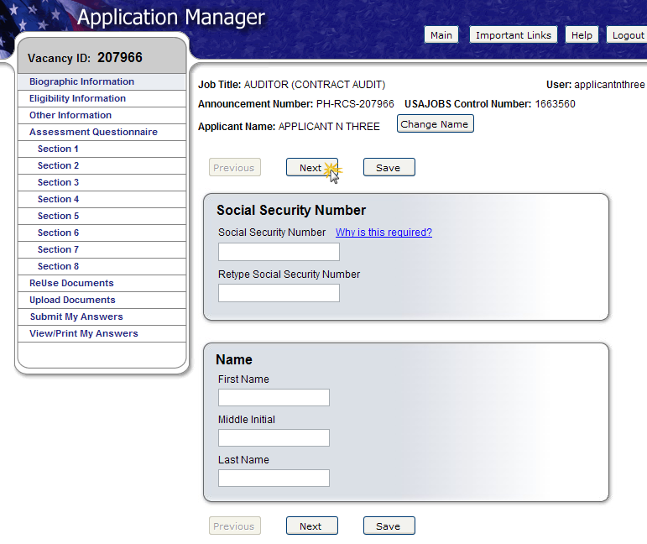
Application Manager
The first time you access Application Manager, you will be required to enter your Social Security Number and your Full Name. It is extremely important that you enter this information accurately and that it matches the information provided in USAJOBS.
If you do not enter the correct SSN, it will affect your consideration for this and future applications.
Application Process • February 2010
14

Slide 15
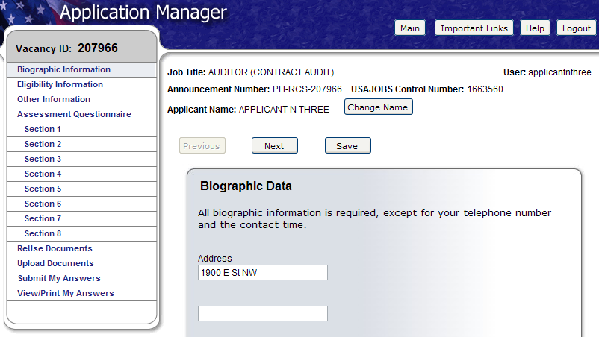
Biographic Data – Eligibility Information
The Biographic Data will be pre-populated with the information you entered in your USAJOBS account. You may need to complete a few more informational pages before you begin your Assessment Questionnaire.
The menu on the left tracks your progress as you complete the application.
Application Process • February 2010
15

Slide 16
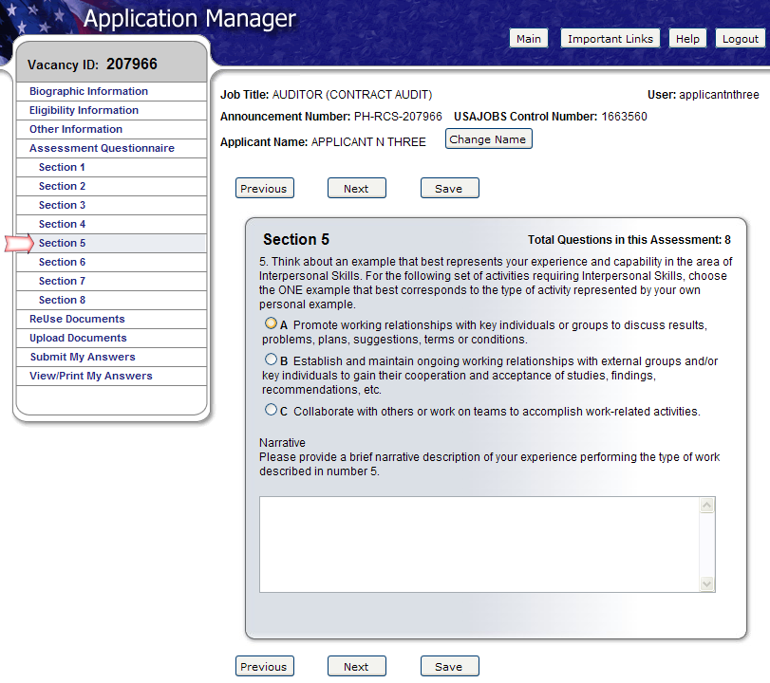
Assessment Questionnaire
The Assessment Questionnaire is divided into sections.
The assessment questions are job specific and change for each job announcement and position.
Application Process • February 2010
16

Slide 17
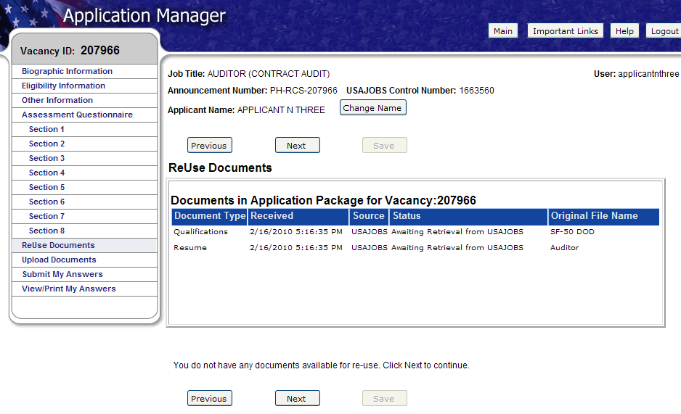
ReUse Documents
The upper table displays the USAJOBS documents for this application. The status will be Awaiting Retrieval from USAJOBS. Once you submit your application, the system will retrieve the documents.
Once you have uploaded documents directly into Application Manager (explained in the next page), these documents will be available for re-use in a table located on the lower part of this same screen.
Application Process • February 2010
17

Slide 18
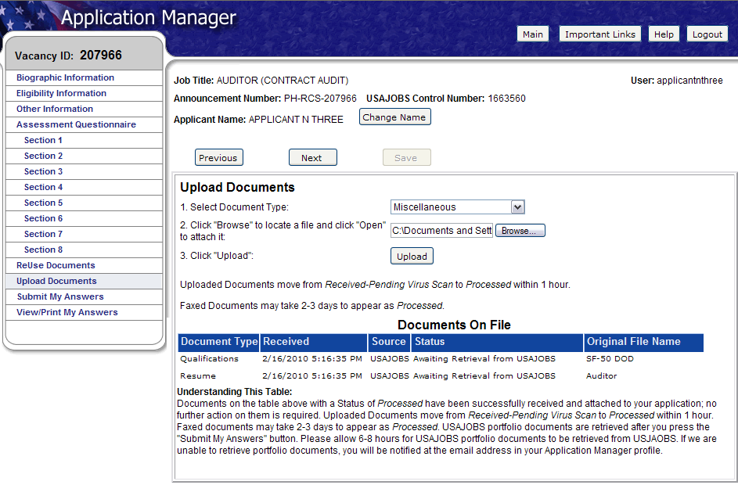
Upload Documents
This section allows you to upload documents that may not be in your USAJOBS account.
Select a document type, browse, and attach the document. The system will confirm the upload was successful and the document will be placed in the Documents On File table.
Documents uploaded in this area will be available in the ReUse Documents section (previous slide) for any future applications.
Application Process • February 2010
18

Slide 19
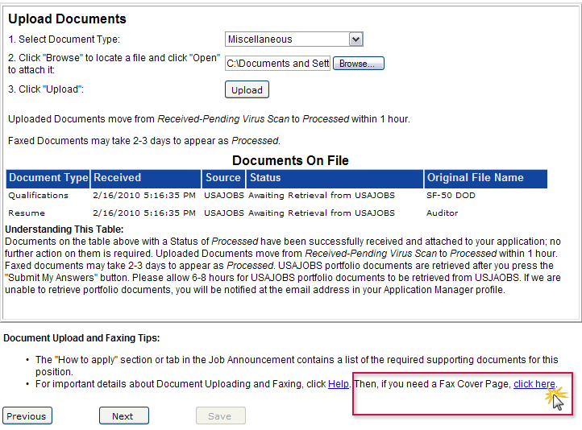
Upload Documents
This section provides a Fax Cover Page for documents you are unable to upload.
This fax cover page is pre-populated with the information required for the fax to be processed for this specific vacancy. The fax number is provided in the How to Apply section of the announcement.
It is important to remember that faxed documents must have this cover page with the correct information filled in, or your documents cannot be associated with this application.
Application Process • February 2010
19

Slide 20
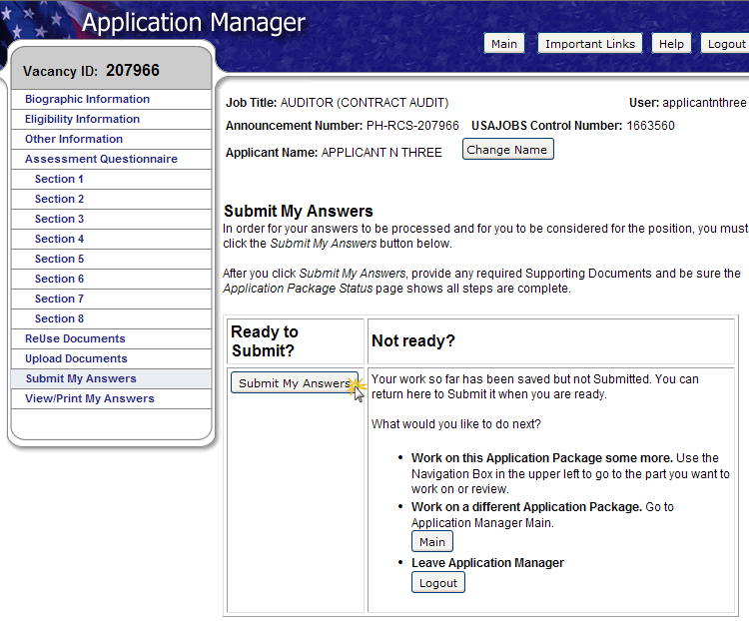
Submit My Answers
Once all required questions have been completed, you will be able to click the Submit My Answers button to submit your application. You must select Submit My Answers or your application will not be received.
If you have skipped any of the required sections, you will receive a warning to go back and complete any missed section before you can submit your answers.
Application Process • February 2010
20

Slide 21
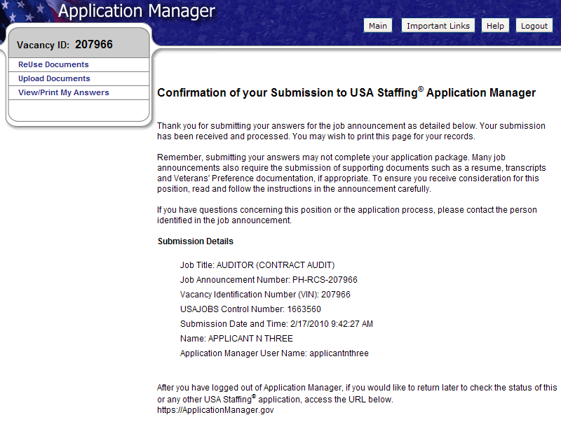
Confirmation Message
Once you click the Submit My Answers button, you will receive an on-line confirmation message.
Submitting your questionnaire responses may not complete your application. It is important that you review the How to Apply section of the vacancy announcement to ensure you comply with all the requirements for your application to be considered as complete.
You may log out or return to USAJOBS at this point.
Application Process • February 2010
21

Slide 22
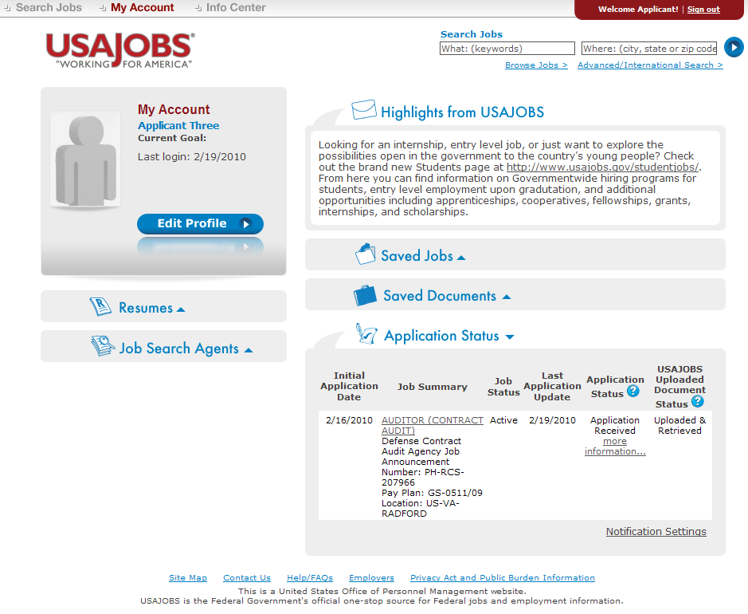
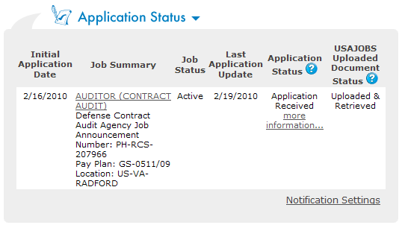
USAJOBS – Application Status
The Application Status Area of your USAJOBS account serves as the main source of information for the status of your online applications. You may use the more information link located under the Application Status column to learn more about the status of your application or view correspondence sent to you by the hiring agency. This link takes you directly into the Details Tab of Application Manager for the selected Application Package.
Application Process • February 2010
22

Slide 23
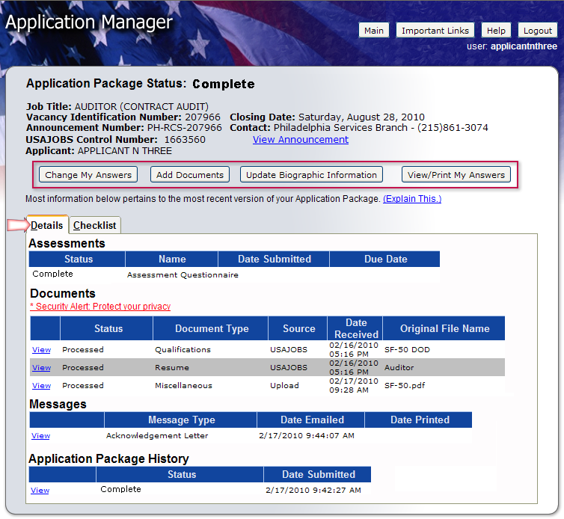
Details Page
From the Details Page you can:
View the Job Announcement
Change your Answers*
Add Documents*
Update Biographic Information
View/Print Your Answers
Review Status of your Assessment and Documents.
View Messages sent by Hiring Agency
View Application Package History
* Changing and resubmitting Answers or adding documents is permitted during the open period only. Once the announcement is closed these features are no longer available.
Application Process • February 2010
23

Slide 24
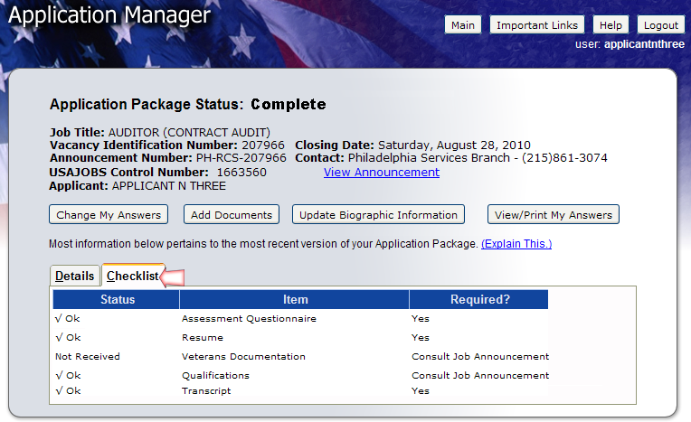
Checklist Page
The Checklist Tab allows you to perform the same functions as the Details Tab. Also it offers a simple view of the status of your Assessment Questionnaire and any Required documents. If the document Status indicates “Not Received” and the document is marked as “Yes” Required, your Application Package Status will indicate: Incomplete.
Application Process • February 2010
24

Slide 25
Remember…
Carefully review Job Announcement and instructions provided in the How to Apply section
Create USAJOBS and Application Manager Accounts if you haven’t done so already
Complete Assessment Questionnaire in Application Manager and submit all required supporting documents online or via fax
Check your Application Status before and after the closing date of the job announcement
Application Process • February 2010
25

Slide 26
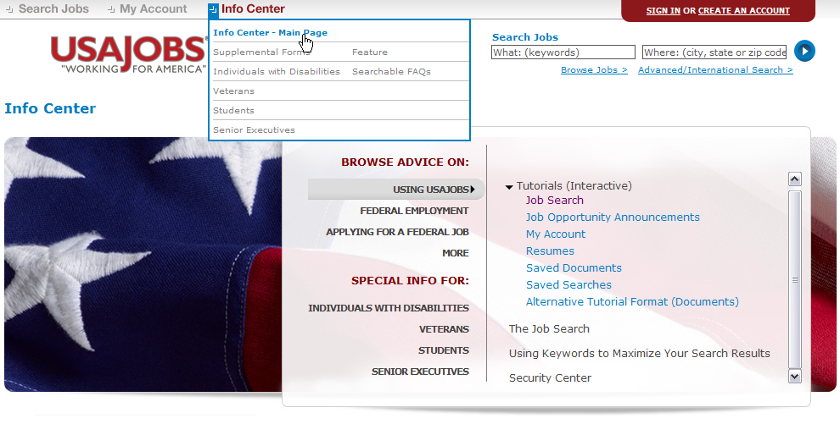
More Information
You may visit USAJOBS’ Information Center – Main Page where you can find tutorials for using different areas of USAJOBS and information about Federal Employment, Applying for Federal Jobs, and Job Search, among others.
Application Process • February 2010
26

